Slide 1
ENSE 470, Milestone 6
ByteThis
Alwin Baby, Konstantin Kharitonov, Taylor Petrychyn
March 28, 2018

Slide 2
Executive summary
Technology used
  Database: PostgreSQL
  Language: Node.js (Backend), jQuery (Frontend)
  Style Framework: Bootstrap 4
User story map changes
  User management moved to future release
  Password recovery/reset backlogged

Slide 3
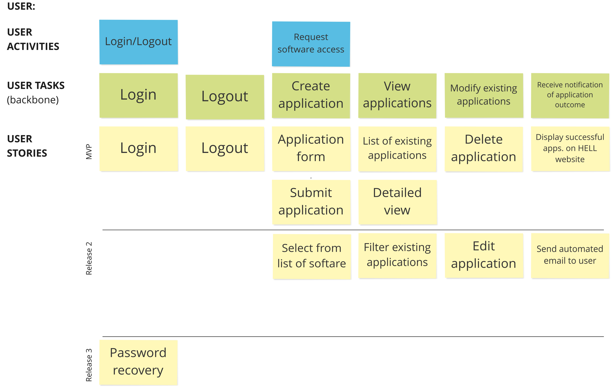
  Notes: Password recovery moved to backlog

Slide 4
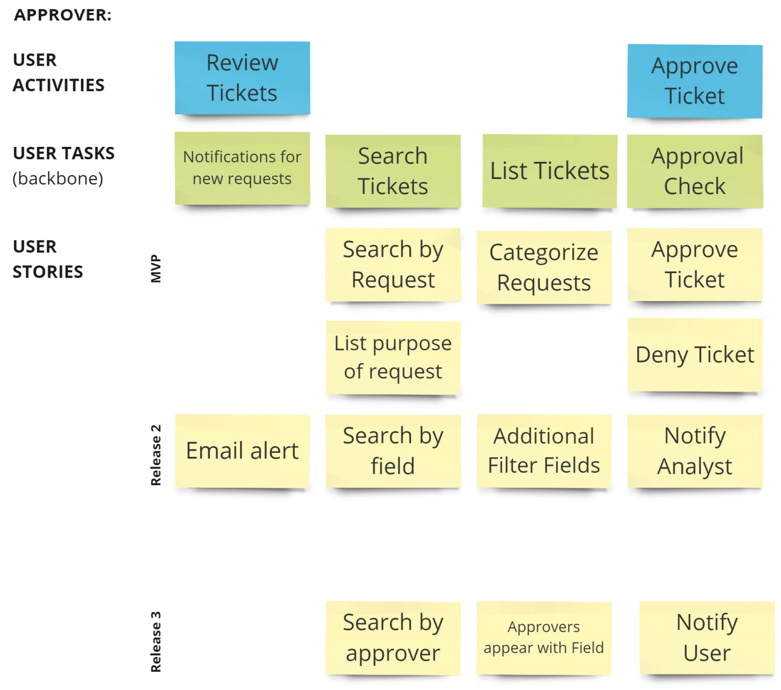

Slide 5
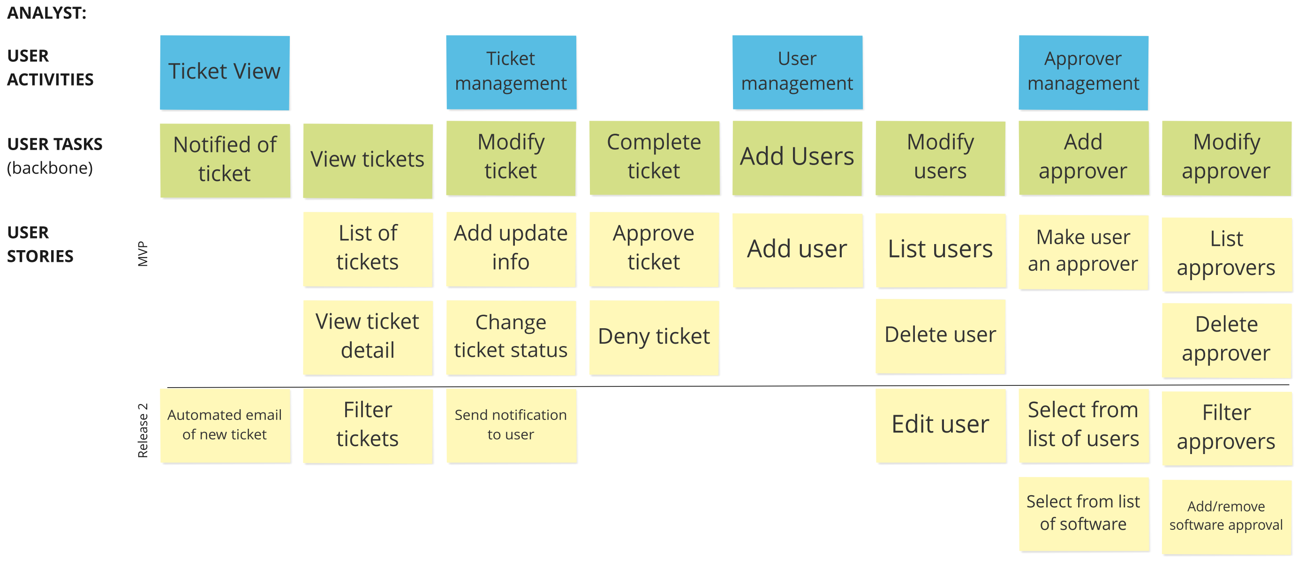
  Notes: User management moved to future release

Slide 6

Design patterns used
1. Decorator
Alerts on top of page after success/failed request
  2. Model-View-Controller
    View (HTML/CSS pages), Controller (Javascript modules for each separate page), Model (Node REST API)
  3. Observer
    Email notification

Slide 7
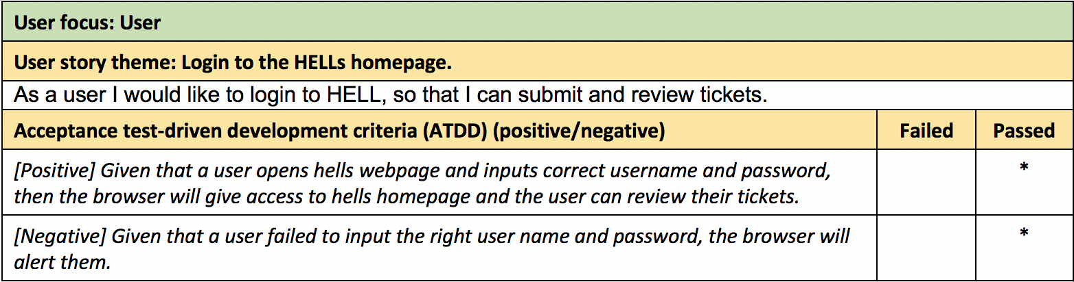
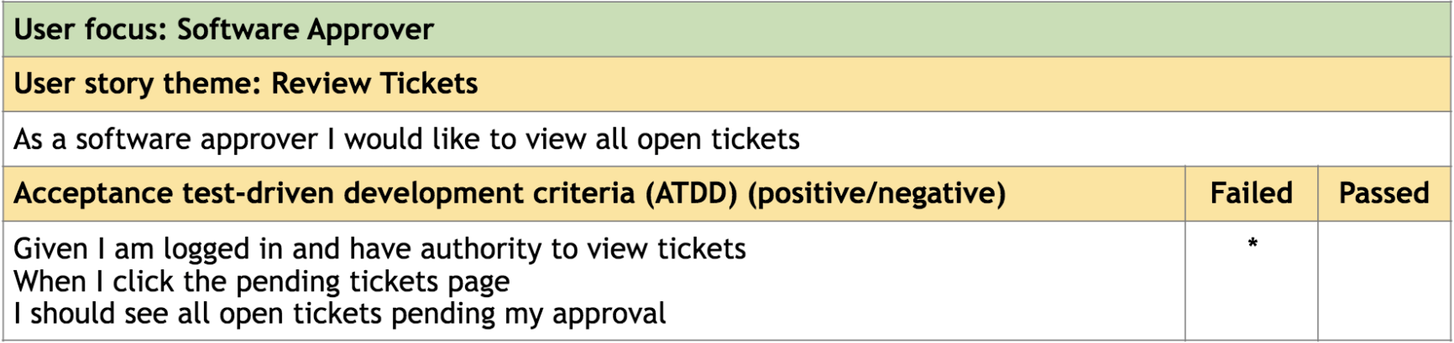
ATDD
*

Slide 8
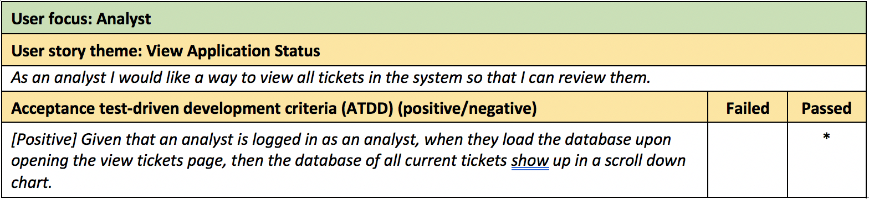

Slide 9
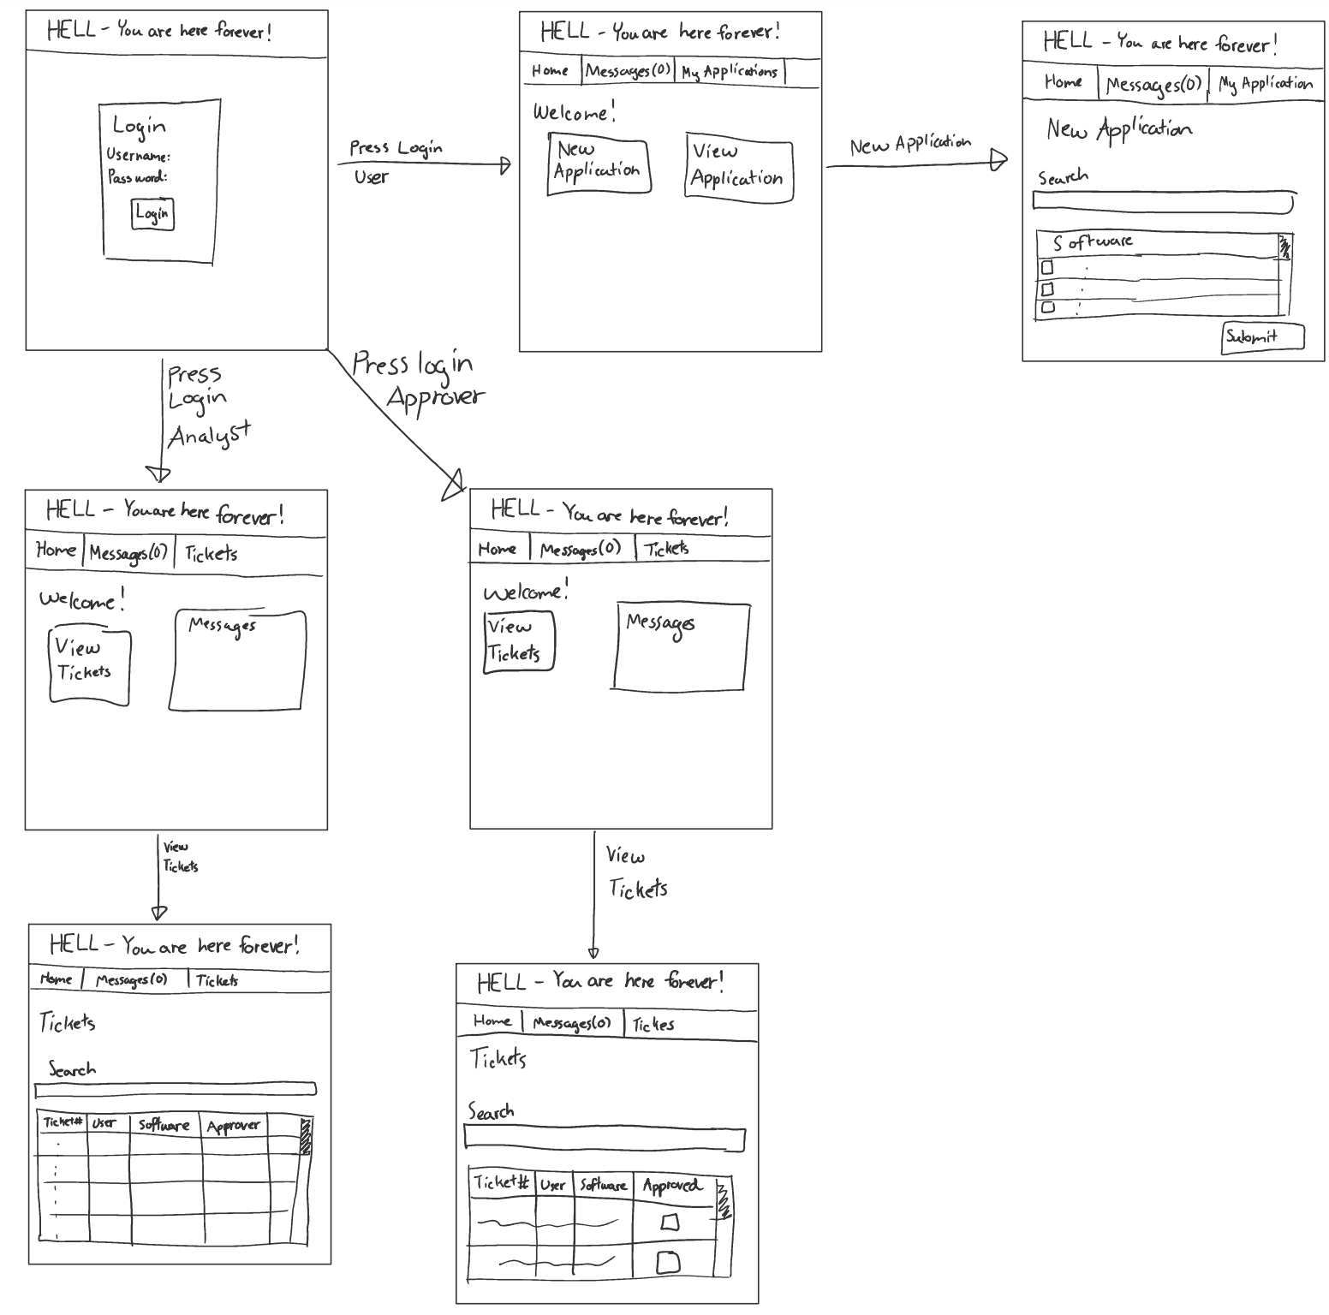

Slide 10
Group reflection
How did you feel about this milestone? What did you like about it? What did you dislike?
  Felt like a lot more work than previous milestones
How will you use what you have learned going forward?
  Can apply knowledge to Software jobs, Capstone

